Slide 1
PRT– S401 B.TECH PROJECT Sign Language Recognition Using Machine Learning .
Under Supervision of
Er. Suruchi Singh
(Assistant Prof.)
Dept. of computer science
and Engineering,
UIET, CSJMU
Presented By: GROUP-1
Roll No | Name .
004 | Adarsh Kr. Nishad
007 | Aishwary Bajpai
050 | Shubham Yadav
CSE (2K18) Final Year

Slide 2
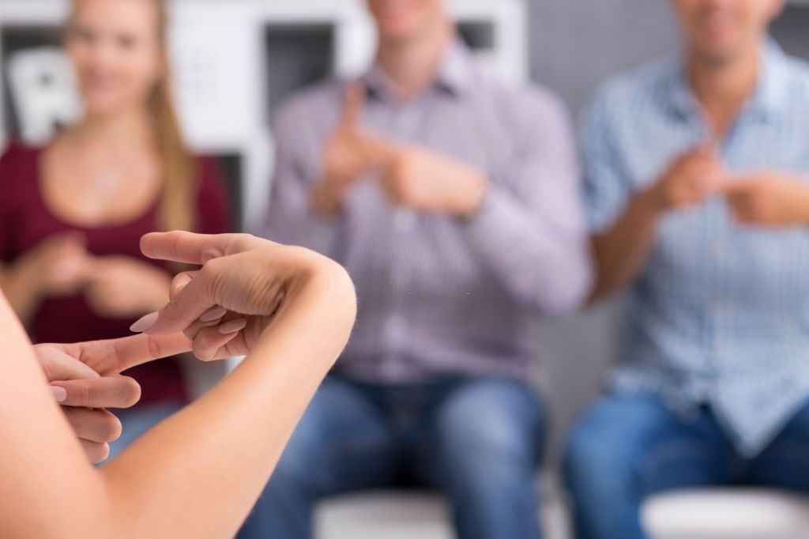
Sign Language Recognition Using Machine Learning

Slide 3
TABLE OF CONTENTS
01
02
03
Project Structure
Data Processing
Training & Saving Modal
04
05
Classifying Gesture on Terminal
Classifying Gesture on Front-End

Slide 4
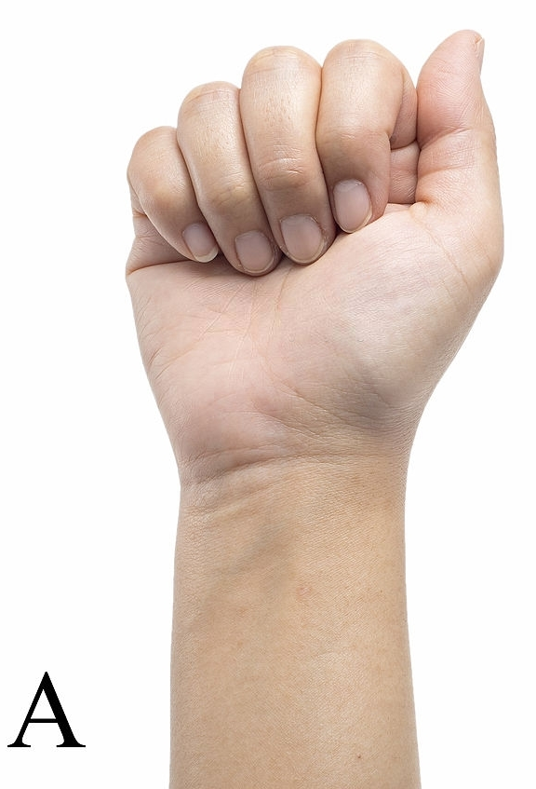
Introduction
Our project aims to create a computer application and train a model which when shown a real time hand gestures of American Sign Language shows the output for that particular sign in text format on the screen.
The Project predict gesture of American Sign Language (ASL).It is purely based on hand gesture.

Slide 5
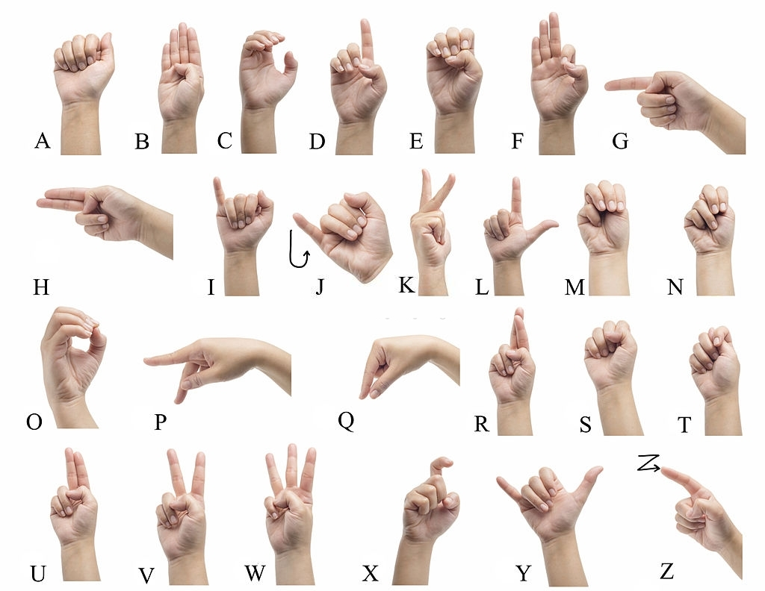

Slide 6
Tools Used
Library Used For Machine Learning Model
Python 3
OpenCV 3
Tensorflow
Keras
For Web Page Development
Html
CSS
Bootstrap
Flask
Ide Used For Development
Anaconda
VS Code

Slide 7
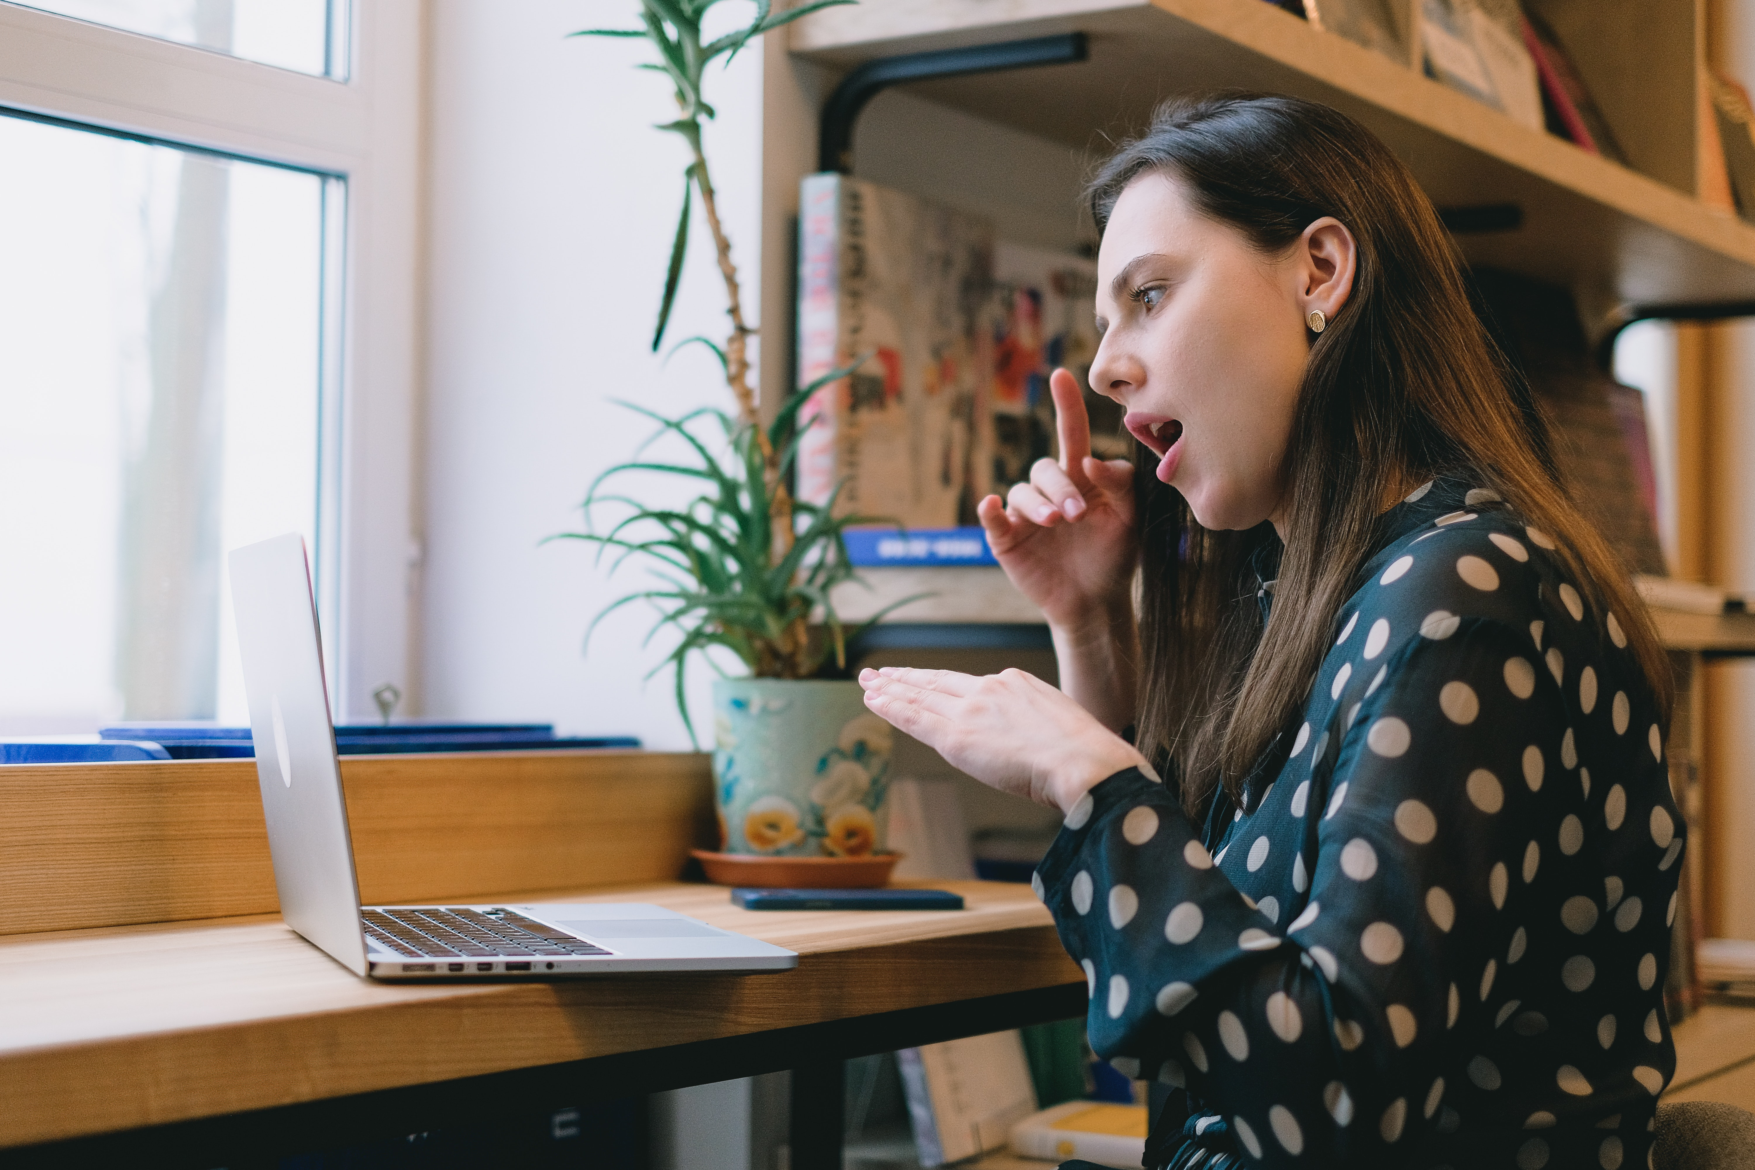
01
Project Structure

Slide 8
Overall Structure of Project

Slide 9
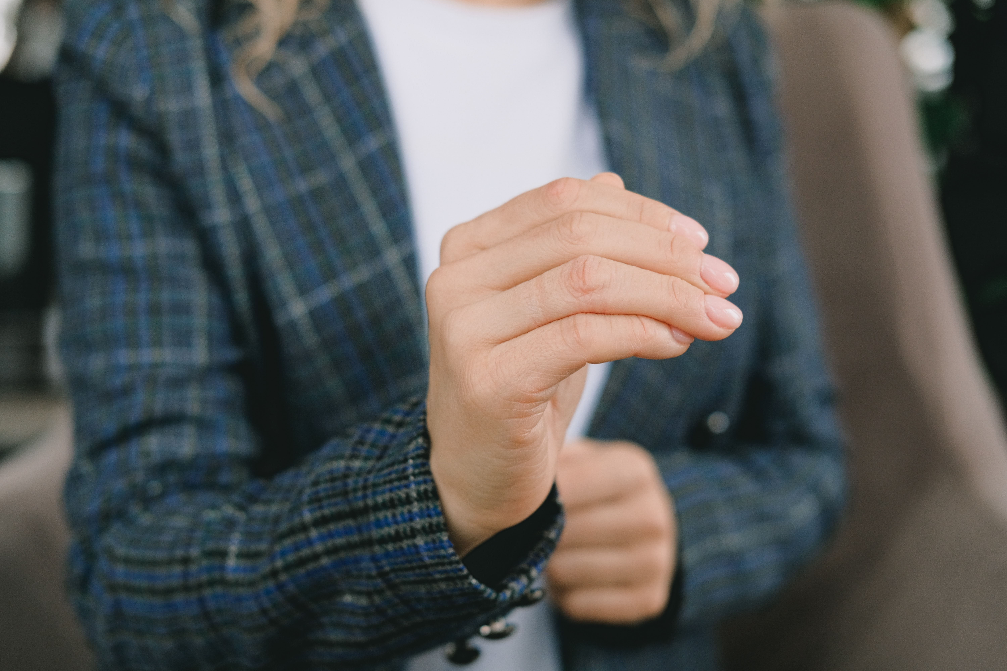
02
Data Processing

Slide 10
Data Collecting And Processing
To create our own Dataset we have a dedicated program which Capture image from webcam.
There is a rectangle frame in test frame to capture desired portion of image.
We Use HSV color model to enhance our images capture from web cam
We include HSV color trackbar to adjust the color .
Images captures from webcam is masked for training purpose.
Total Image For
Training->26*1750=45500
Testing->26*250=6500

Slide 11
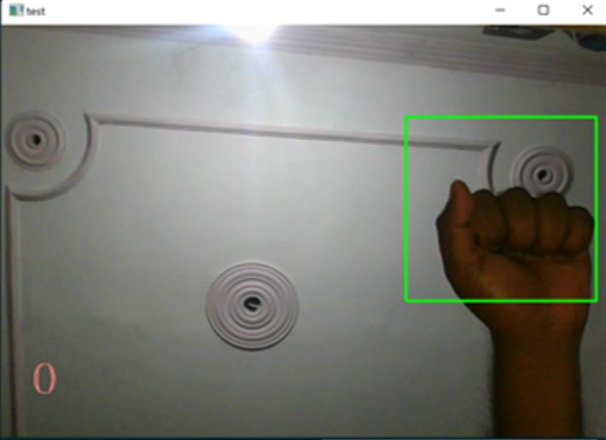
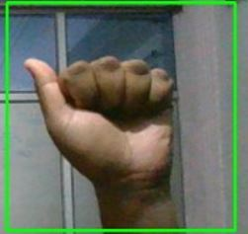
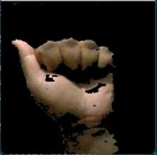
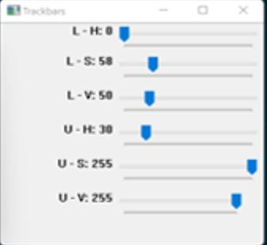
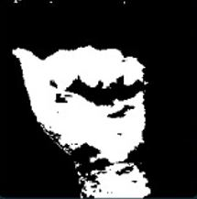
Capture & Clip Out
Masking Image using HSV Trackbar

Slide 12
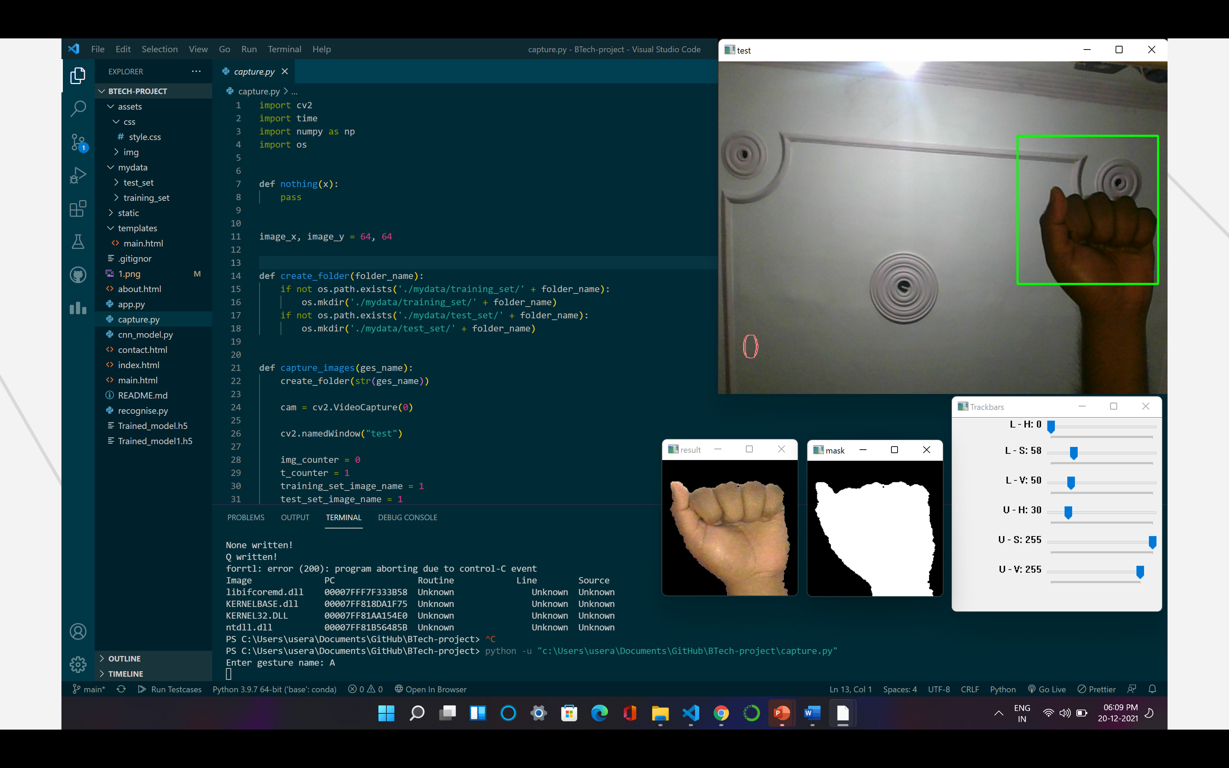
Data Processing .

Slide 13
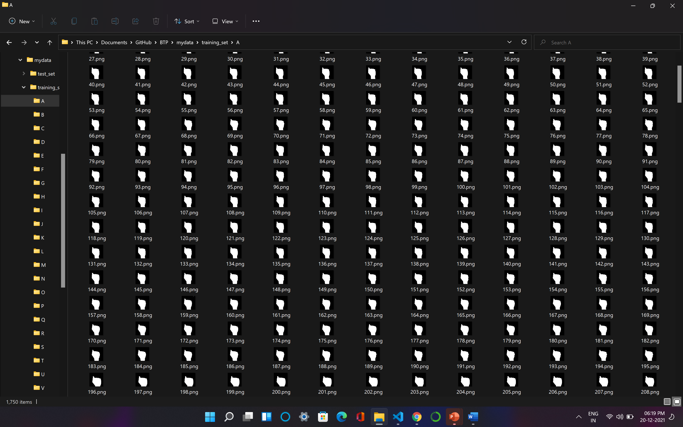
Dataset

Slide 14
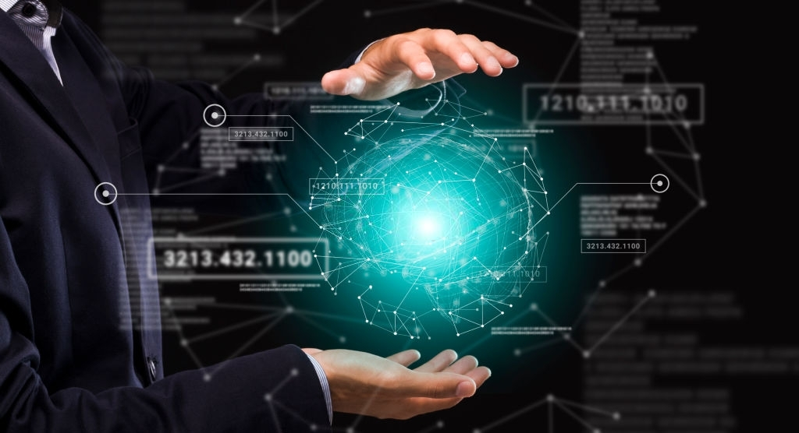
03
Training & Saving Modal

Slide 15
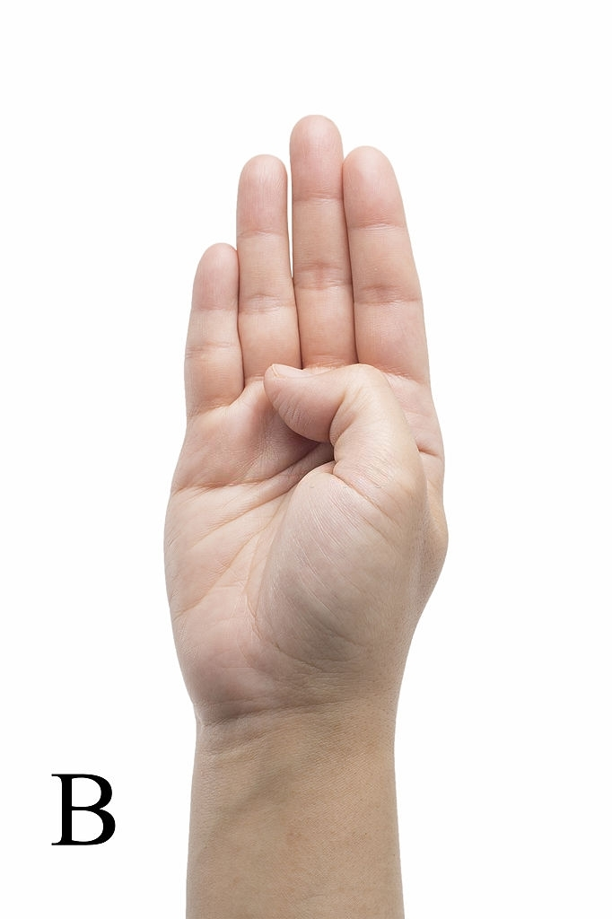
Training CNN Modal
A Convolutional Neural Network (CNN) is a Deep Learning algorithm which can take in an input image, assign importance (learnable weights and biases) to various aspects/objects in the image and be able to differentiate one from the other.
CNN MODEL LAYER 1
After converting RGB image into HSV followed by masking is given as input to the first layer.
This processed image when passed to the first layer it detects the edges in the image.
All Cnn models first layers works on detecting the edges in the image.
Layer also known as Edge detection layer.

Slide 16
Training CNN Modal
CNN MODEL LAYER 2
Output of Layer 1 is applied to this layer .
This layer is a composition of convolution and Max pooling.
The purpose of this layer is to learn all the features, shapes of the particular symbol and recognize the 26 symbols separately.

Slide 17
Training CNN Modal
CNN MODEL LAYER 3
We detect that upto layer 2 the output is not able to classify the symbol having almost similar hand signs.eg- (M,N,T) .hence, model upto layer 2 end up giving us low accuracy on testing data.
The significance of this layer is to increase the testing accuracy by classifying the symbols which have almost similar hand signs.
This layer also contains convolutional layer followed by max pooling layer so the output from layer 3 will have less parameters to feed in to the fully connected layer.

Slide 18
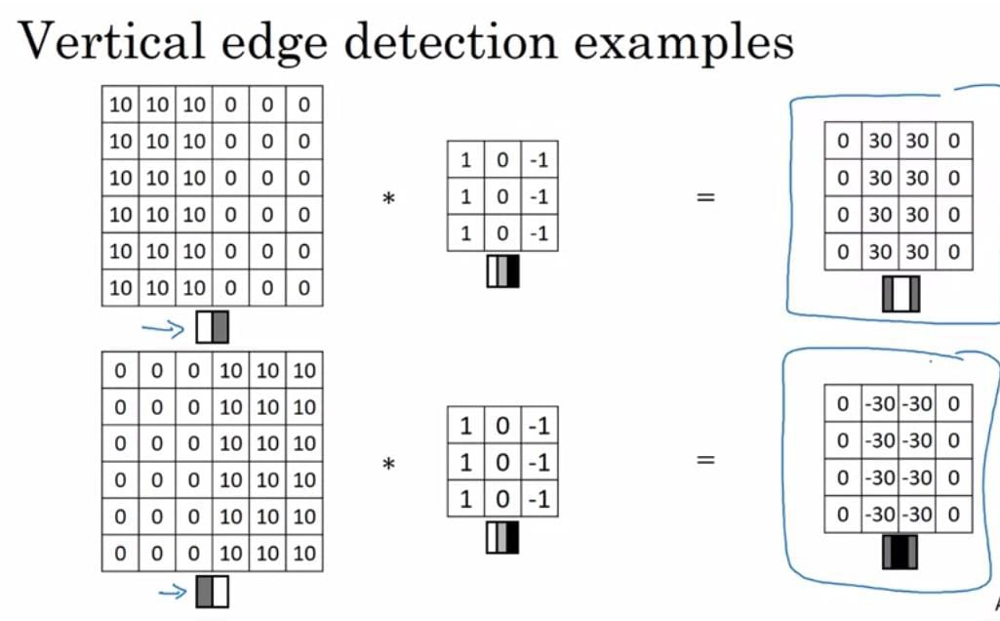
Convolutional layer

Slide 19
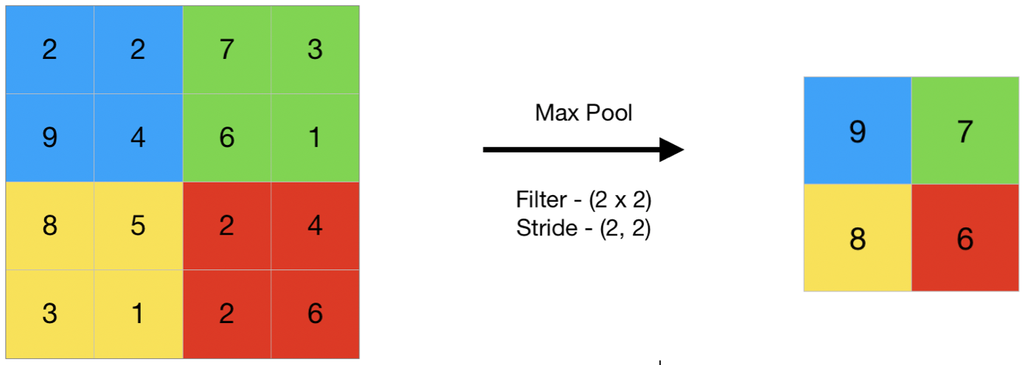
Max pooling

Slide 20
BLOCK MODEL
64X64X3
32@3X3
CONVOLUTION
OUTPUT
62X62X32
MAX POOLING
2X2
31X31X32
FULLY CONNECTED LAYER
CONVOLUTION
29X29X32
FLATTEN
MAX POOLING
12X12X32
14X14X32
1152
MAX POOLING
CONVOLUTION

Slide 21
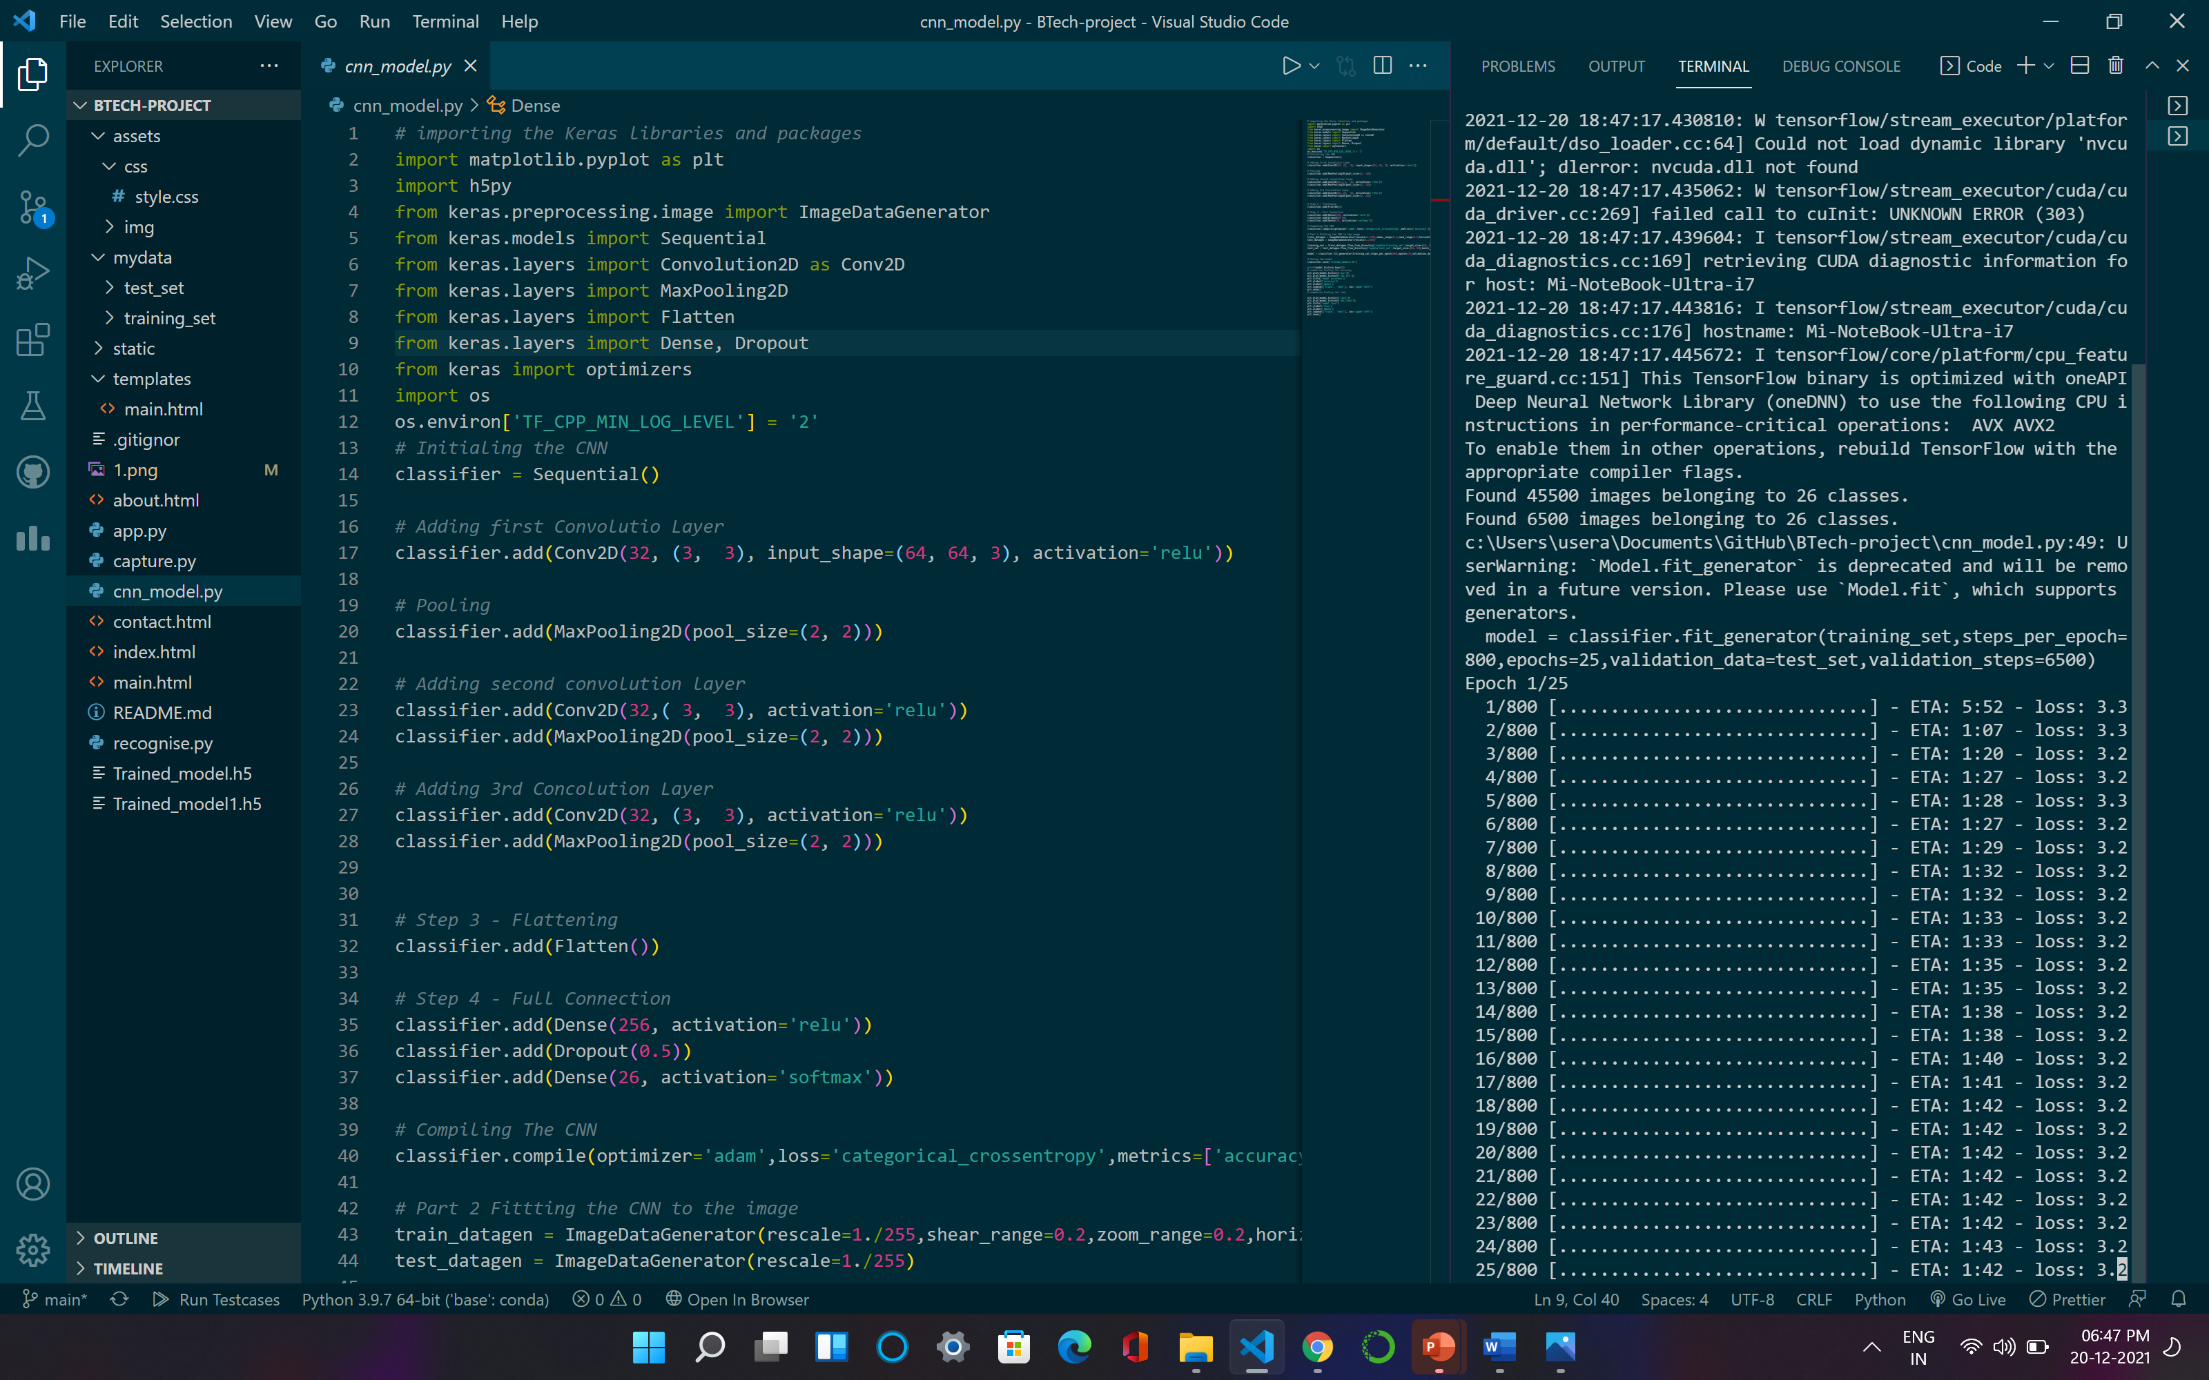
Training & Saving CNN Modal

Slide 22
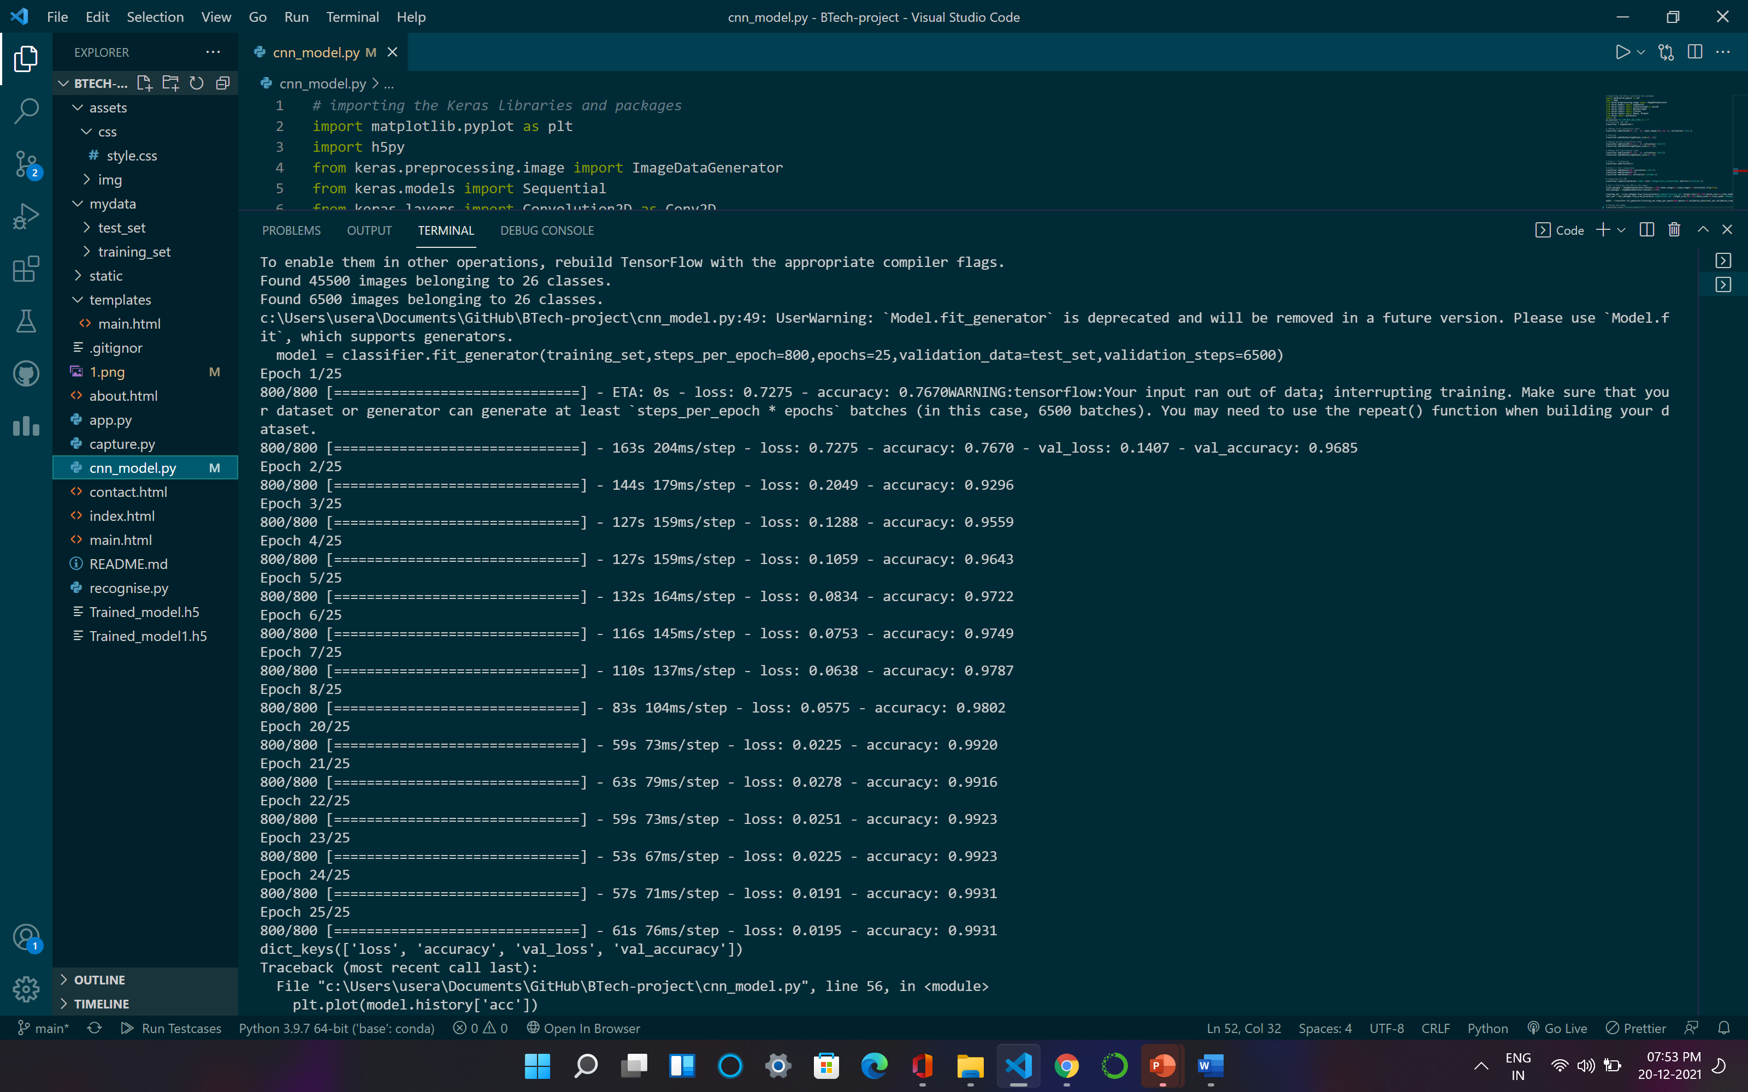
Training & Saving CNN Modal

Slide 23
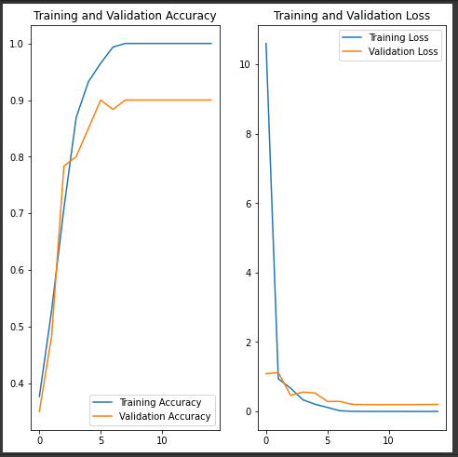

Slide 24
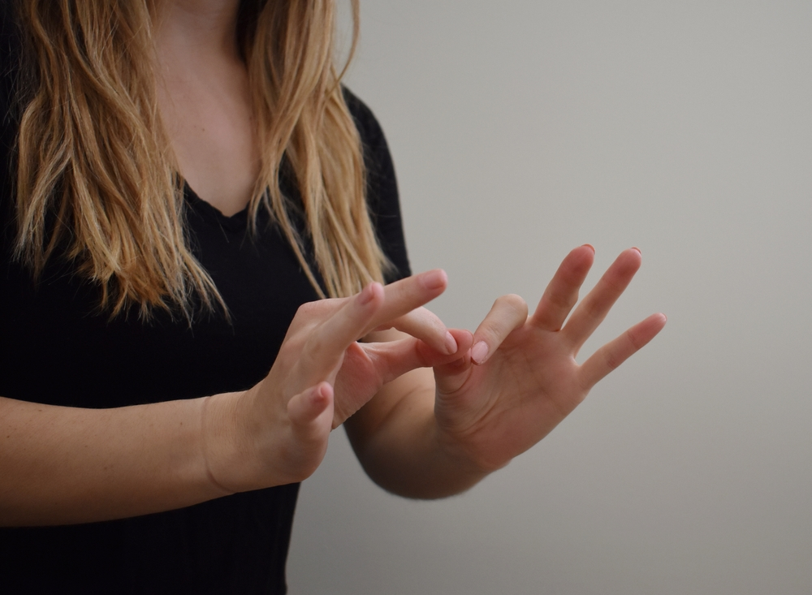
04
Classifying Gesture
on Terminal

Slide 25
Classifying Gesture on Terminal
On executing the program three windows will appear on screen.First window is used to capture the image. This frame contains a green colour rectangle which is referred as ROI.
Second windows contain trackbars. These trackbars are used to detect the human skin out of the roi.
Third window is mask which show the extracted image after performing masking.
The text will be presented on the screen which is the prediction given by our model on that masked image.

Slide 26

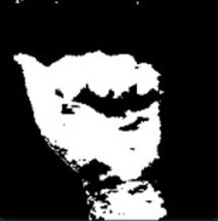
Classifying Gesture : Working Layout
LAYER 1
LAYER 2
LAYER 3
NEURAL NETWORK
Probablity of each symbol being shown as input

Slide 27
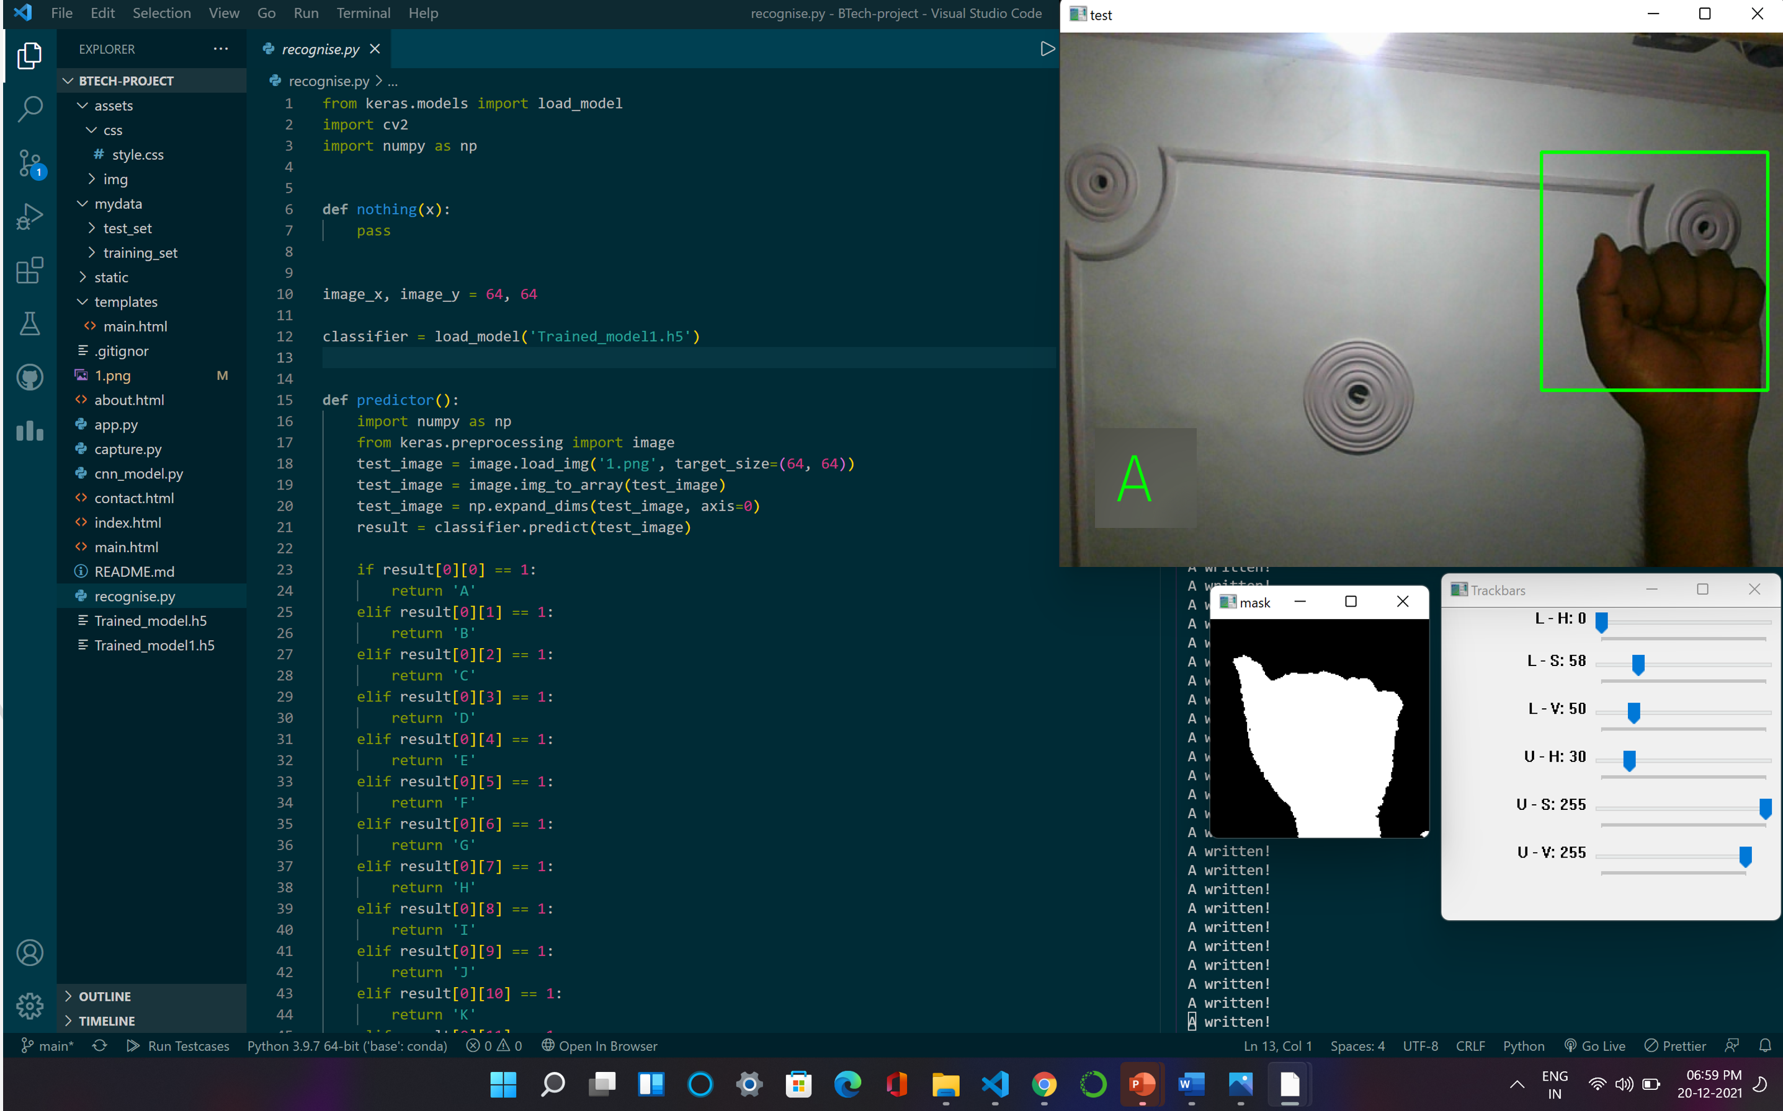
Classifying Gesture on Terminal

Slide 28
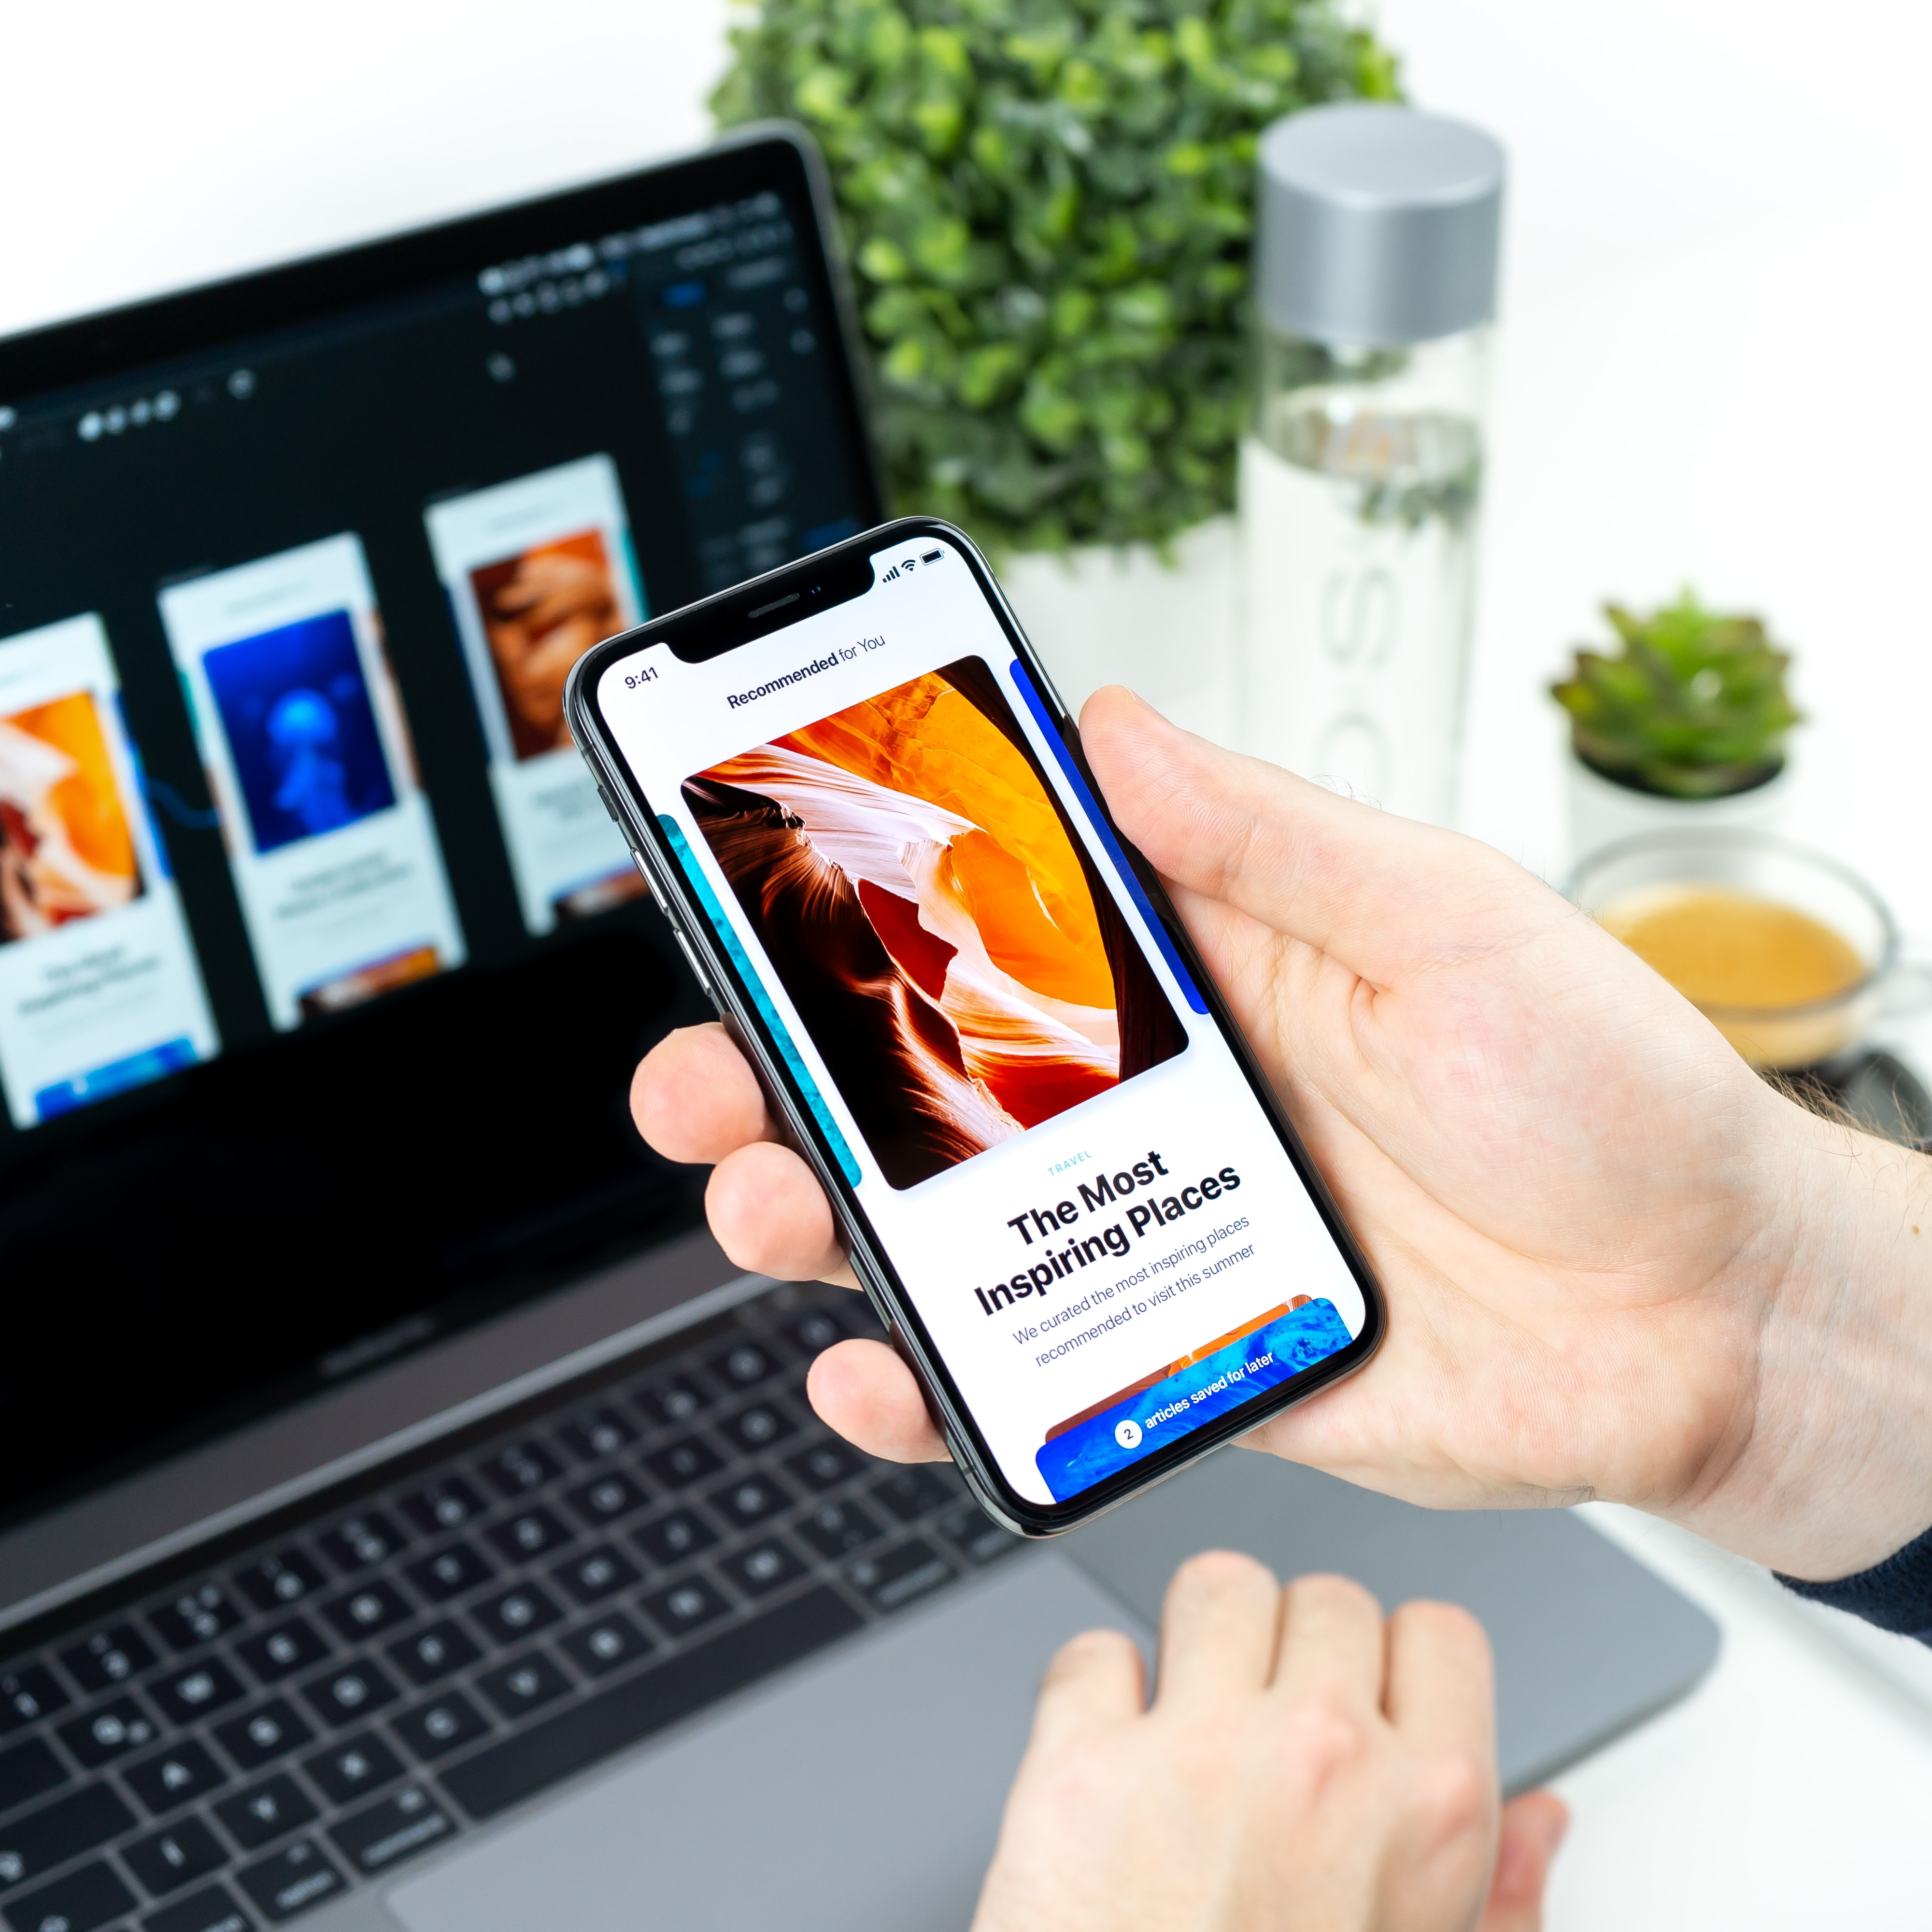
05
Classifying Gesture on Webpage (front-end)

Slide 29
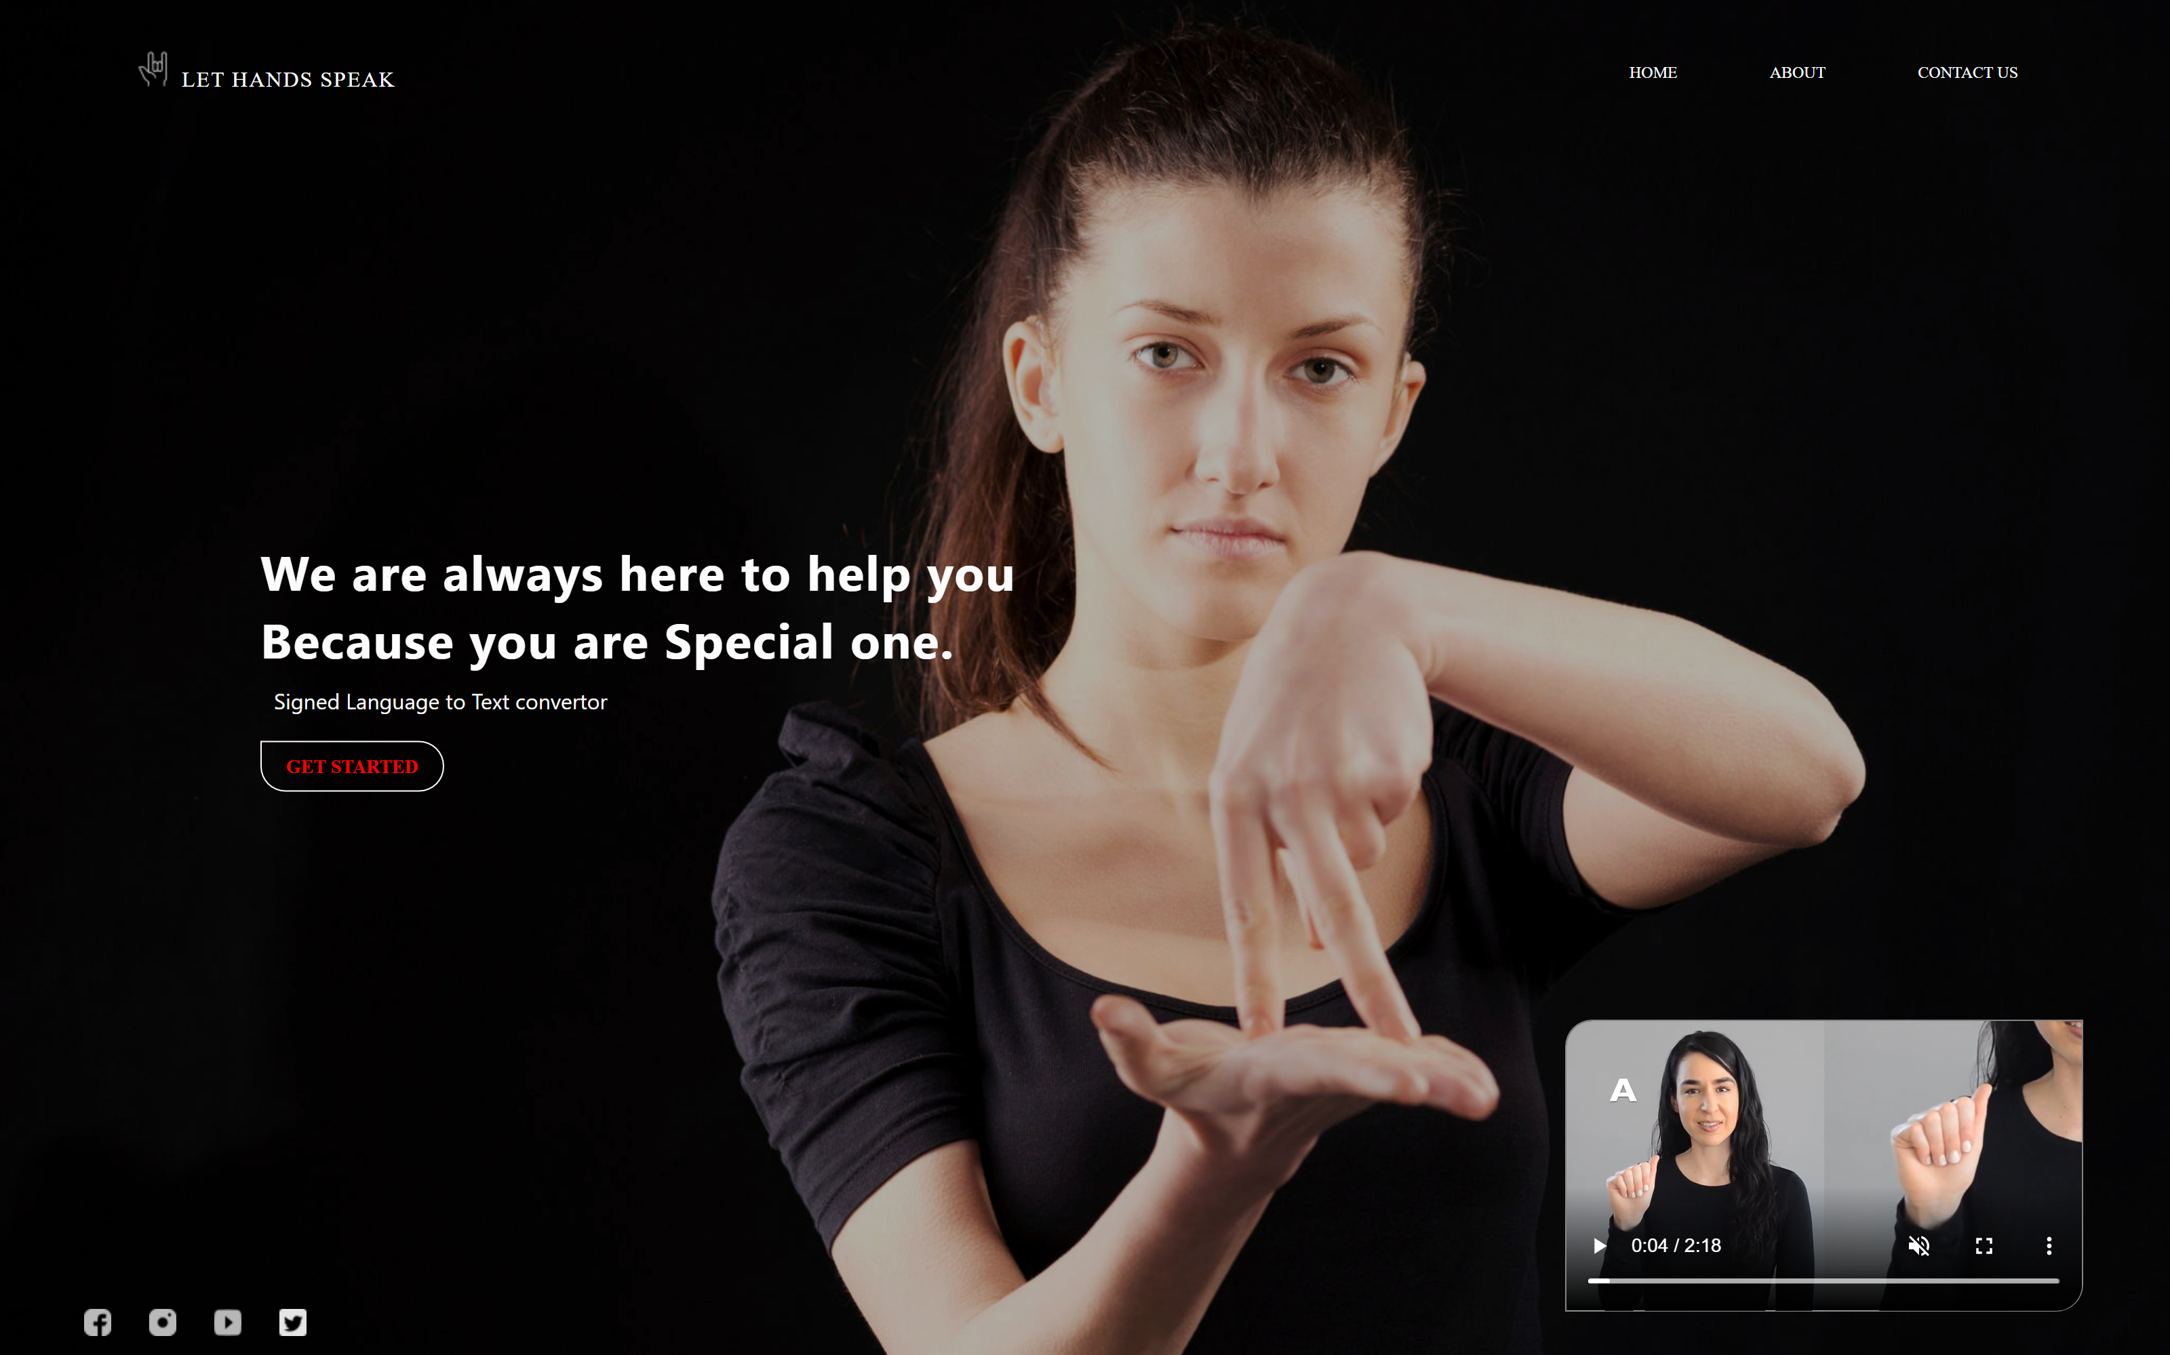
Let Hands Speak – Home page (Front End)

Slide 30
Classifying Gesture on WebPage (Front-end)
Flask is a micro web framework written in Python.
It is classified as a microframework because it does not require particular tools or libraries.
OpenCV is the huge open-source library for the computer vision, machine learning, and image processing.

Slide 31
Classifying Gesture on WebPage (Front-end)
Steps involved in taking video Frames for webpage:
Step1- Importing Flask & OpenCV .
Step2- Import necessary libraries, initialize the flask app.
Step3- Capture Video using OpenCV.
Step4- Adding window and generating frames from the camera.
Step5- Define app route for default page of the web-app.
Step6- Define app route for the Video feed.
Step7- Starting the Flask Server .

Slide 32
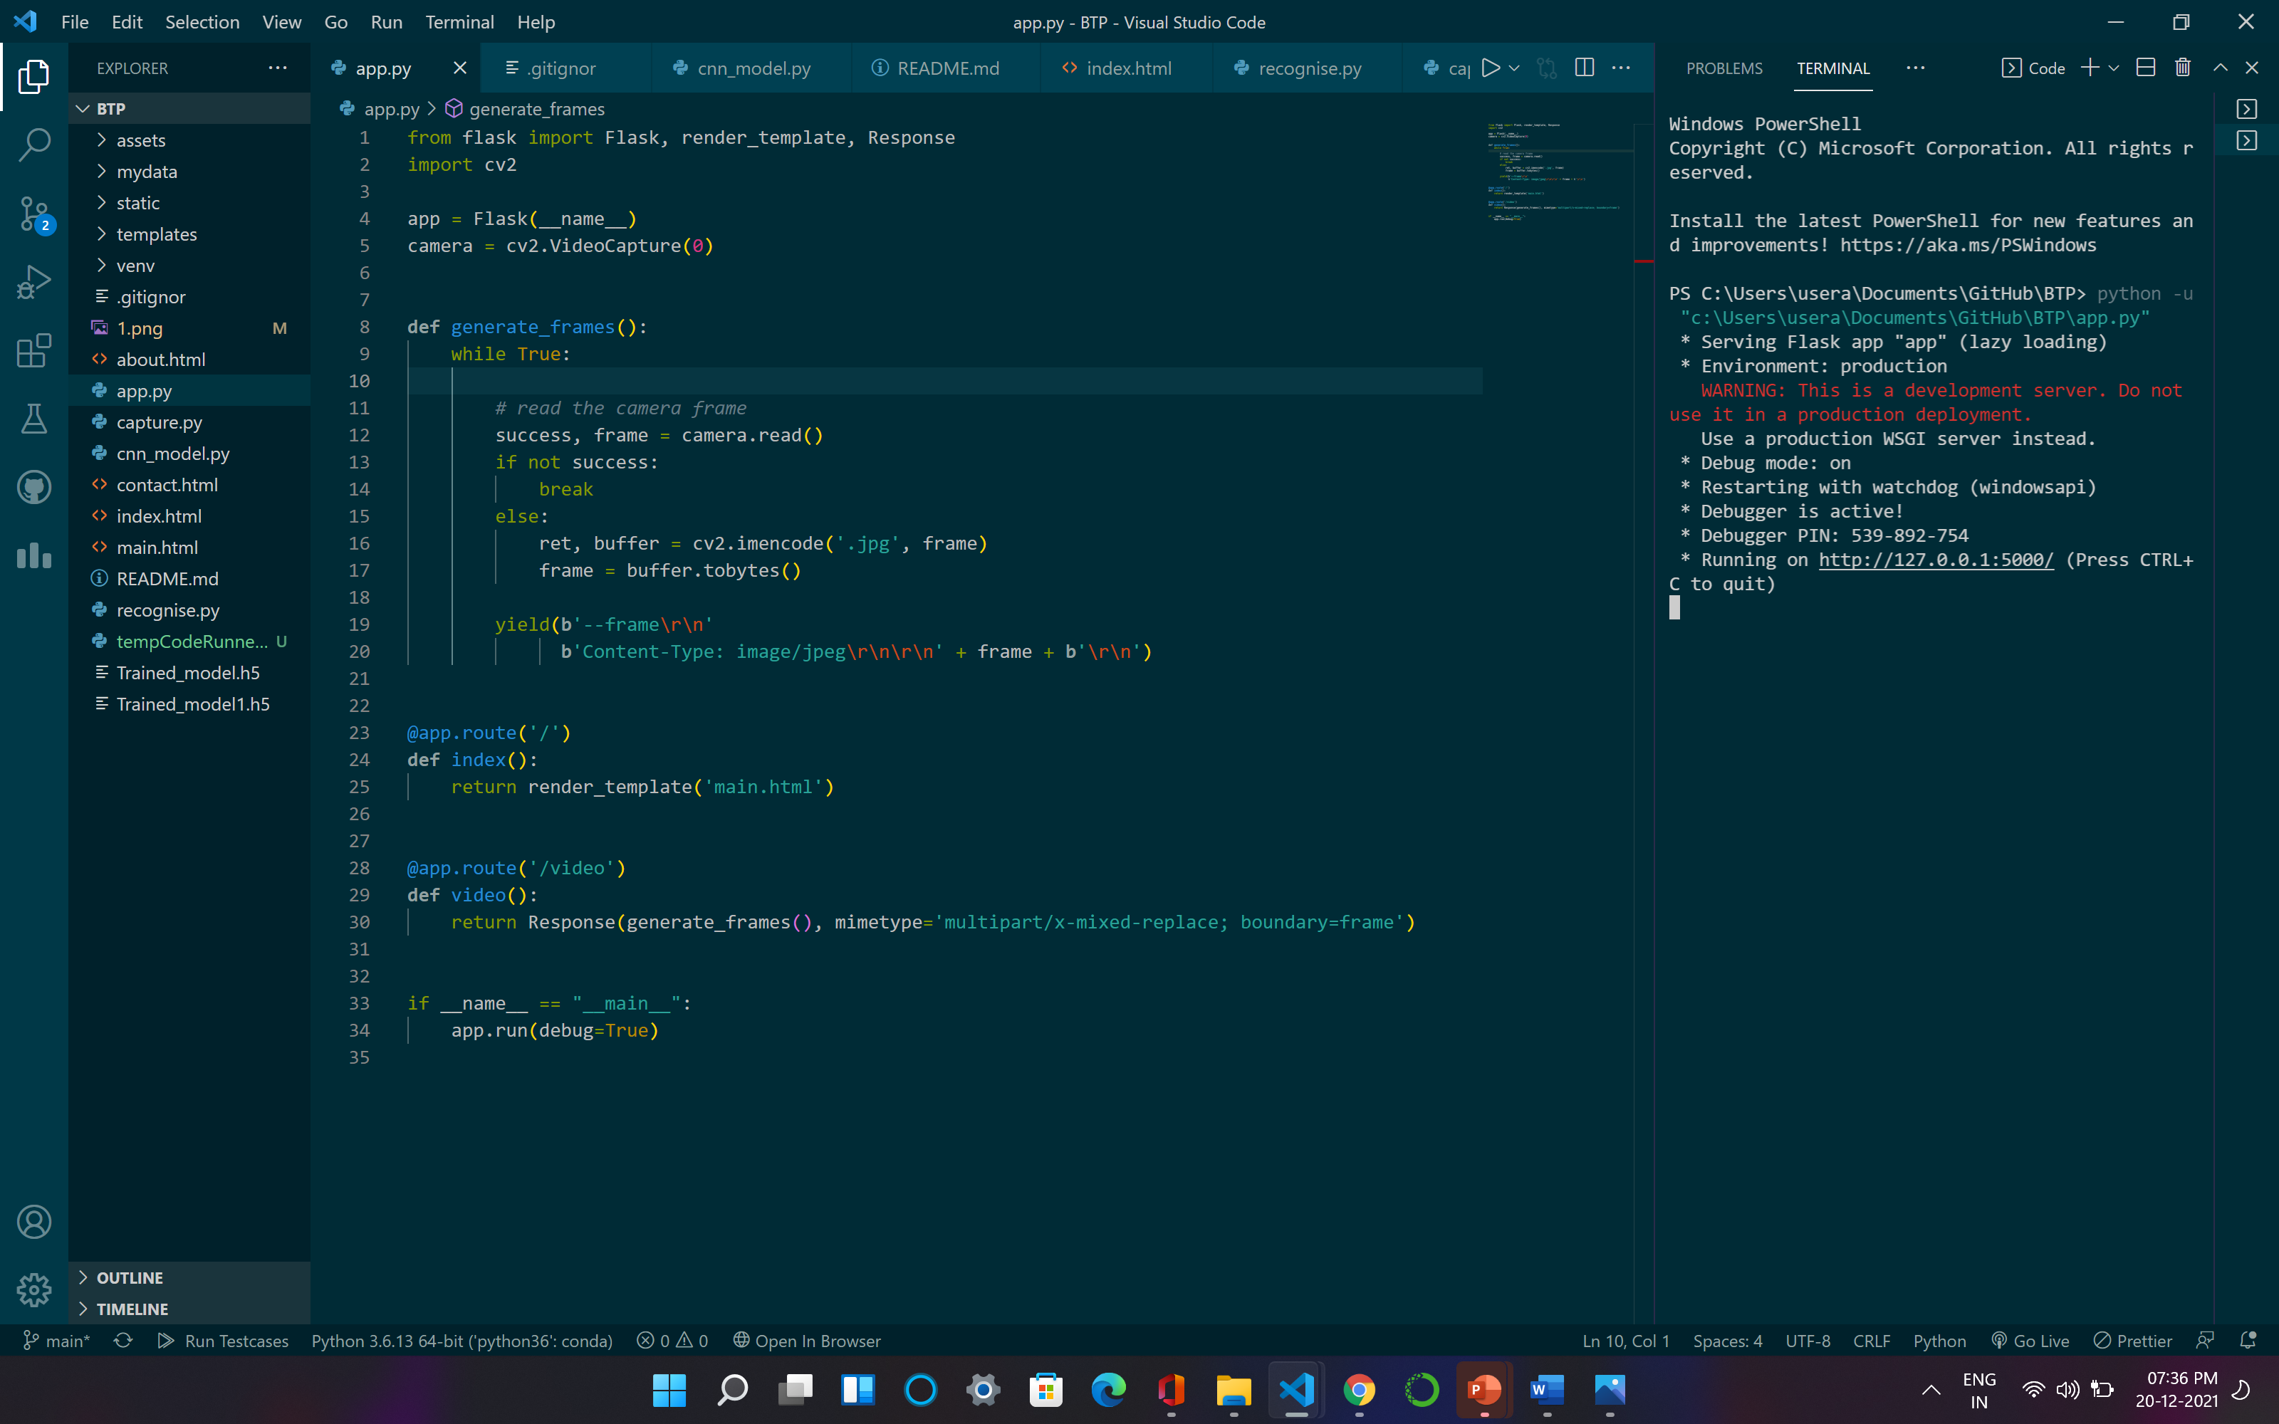
Classifying Gesture using Flask

Slide 33
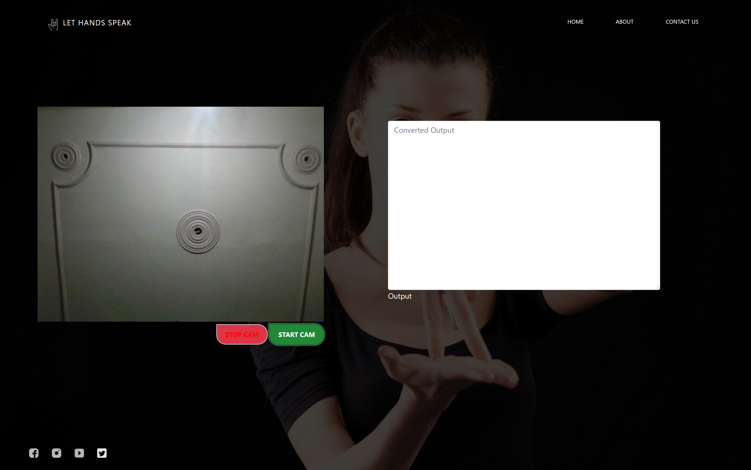
Classifying Gesture on WebPage (Front-end)

Slide 34
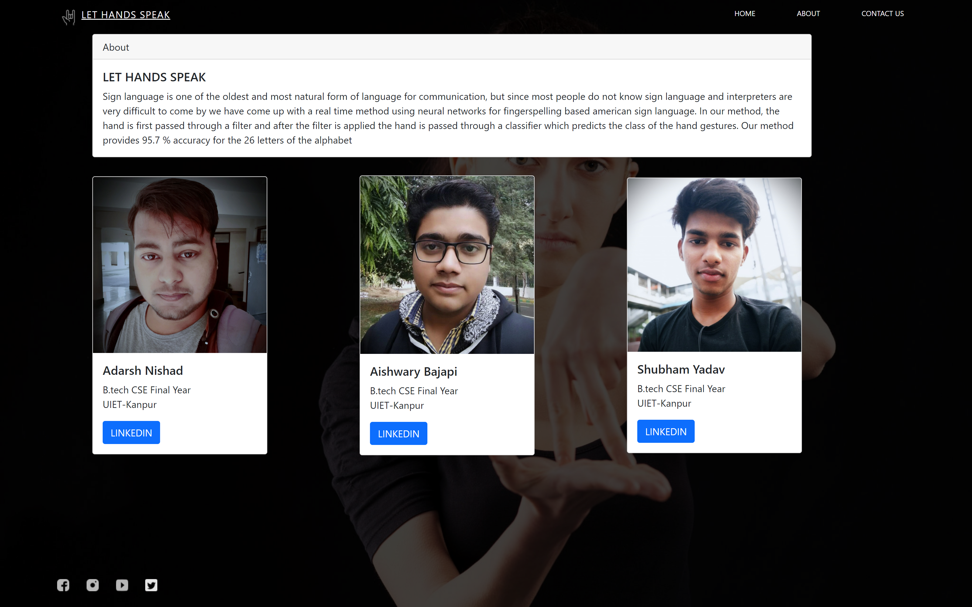
Let Hands Speak – About us (Front End)

Slide 35

THANKS End of Slide

